Slide 1

WINNING SPACE RACE WITH DATA SCIENCE
Ehab Elgamal
April 2023

Slide 2
Outline
Executive Summary
Introduction
Methodology
Results
Conclusions
Appendix

Slide 3

EXECUTIVE SUMMARY

Slide 4
Methodology
Data collection
Data wrangling
EDA with data visualization
EDA with SQL
Building an interactive map with Folium
Building a dashboard with Plotly Dash
Predictive analysis (Classification)
Results
Insights from EDA with Visualization
Insights from EDA with SQL
Insights from Launch Sites Proximities Analysis
Insights from Dashboard
Results of Predictive Analysis

Slide 5
INTRODUCTION

Slide 6
SPACE X advertises FALCON 9 rocket launches on its website with a cost of 62 million dollars; other providers cost upward of 165 million dollars each, much of the savings is because SpaceX can reuse the first stage.
Prediction if the first stage would land allows the cost of a launch could be determined.
The task of this project was to predict if the FALCON 9 first stage would land successfully.

Slide 7
METHODOLOGY

Slide 8
Data Collection
SPACE X launch data was collected from SPACE X REST-API that revealed data about launches, rocket used, payload delivered, launch specifications, landing specifications & landing outcome.
SPACE X REST-API endpoint used was that started with
api.spacexdata.com/v4/launches/past
Python BeautifulSoup package was used to webscrape some HTML tables that contained valuable FALCON 9 launch records in the related WIKI pages.

Slide 9
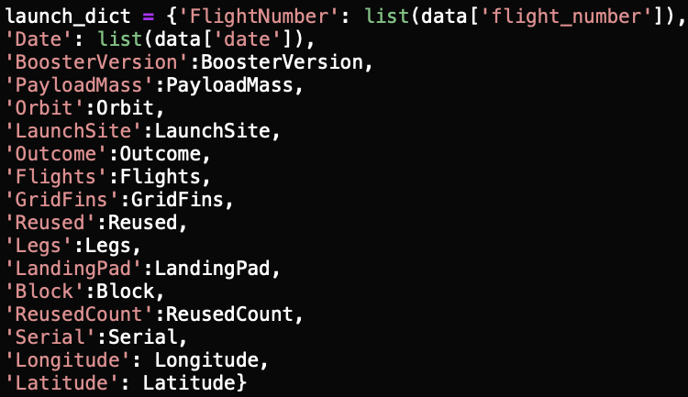
SPACE X REST-API
1. Requesting Response from API:
2. Converting Response to .json File:
3. Applying custom functions to extract information from
launch data:
4. Construction of the dataset:
5. Filtering & exporting to csv file:

Slide 10
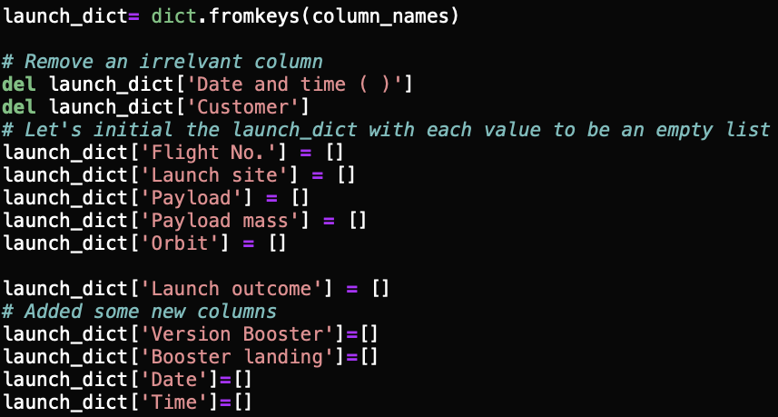
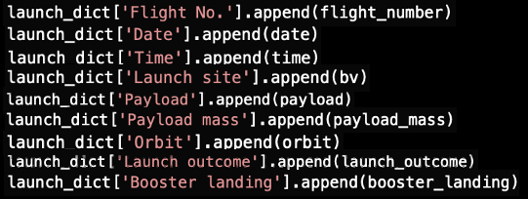
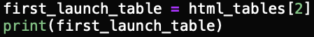
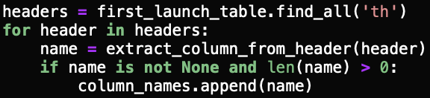
Webscraping
1. Requesting FALCON 9 launch wiki page from its URL:
2. Creating BeautifulSoup object:
3. Finding tables:
4. Extracting column names:
5. Creating a dictionary:
6. Filling dictionary with launch records:
7. Creating dataframe & exporting to csv file:

Slide 11
Data Wrangling
Using the collected dataset, the attributes Flight Number, Date, Booster Version, Payload Mass, Orbit, Launch Site, Outcome, Flights, Grid Fins, Reused, Legs, Landing pad, Block, Reused Count, Serial, Longitude & Latitude of launch were reviewed.
The column Outcome indicated if first stage successfully landed, there was 8 of them with True meaning that booster landed successfully to a drone ship & False meaning that it was unsuccessful.
Landing Outcome was converted to classes 0 & 1 using one hot encoding with 0 denoting bad outcome & 1 denoting good outcome.

Slide 12
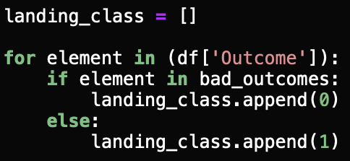
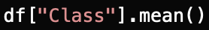
Data Wrangling
1. Checking null values:
2. Calculating the number of launches on each site:
3. Calculating the number & occurance of each orbit:
4. Calculating the number & occurance of mission
outcome per orbit type:
5. Creating a set of outcomes where the second stage
did not land successfully:
6. Creating a landing outcome label from outcome column:
7. Determining the success rate:

Slide 13
EDA with Data Visulaization
Some attributes were used to determine if first stage can be reused.
It was observed that success rate since 2013 has improved.
Different launch sites had different success rates, as a result, they could be used to help determining if first stage would land successfully.
It was noticed that CCAFS LC-40 had a success rate of 60% while KSC LC-39A and VAFB SLC 4E had a success rate of around 77%.
When the result of the landing outcomes were overlayed as a colour it was noticed that CCAFS LC-40 had a success rate of 60% but if the mass was above 10,000 kg the success rate was 100%.

Slide 14
EDA with SQL
SQL queries performed include:
Displaying the names of the unique launch sites in the space mission.
Displaying 5 records where launch sites began with the string ‘CCA’.
Displaying the total payload mass carried by boosters launched by NASA (CRS)
Displaying average payload mass carried by booster version F9 v1.1.
Listing the date when the first successful landing outcome in ground pad was achieved.
Listing the names of the boosters which had success in drone ship and had payload mass
> 4000 but < 6000.
Listing the total number of successful & failure mission outcomes.
Listing the names of booster_versions which had carried the maximum payload mass using
a subquery.
Listing the records that displayed the month names, failure landing_outcomes in drone ship,
booster versions, launch_site for the months in year 2015.
Ranking the count of successful landing_outcomes between the date 04-06-2010 and
20-03-2017 in descending order.

Slide 15
Building an Interactive Map with Folium
Launch site locations & their close proximities were marked by creation & adding folium.Circle and folium.Marker for each launch site on the site map.
Markers for all launch records were added so that If a launch was successful (class=1), a green marker was used and if a launch was failed, a red marker (class=0) was used.
A Polyline between a launch site to a selected coastline point, raliway, highway and a city map symbol were added.
The target was to explain how an optimal launch site was chosen.

Slide 16
Building a Dashboard with Plotly Dash
A dashboard application was built with Plotly Dash package.
The dashboard contained input components such as dropdown list and a range slider to interact with a pie chart and a scatter point chart.
The target was to find more insights from the SPACE X dataset more easily than with static graphs.

Slide 17
Predictive Analysis (Classification)
Machine Learning pipeline was built to predict if first stage of the FALCON 9 would land successfully. It included:
Preprocessing: allowing to standardize the data.
Train_test_split: allowing to split the data into training & testing subsets.
Training the model & performing Grid Search: allowing to to find the
hyperparameters that allow a given algorithm to perform best. Using the
hyperparameter values, the model with the best accuracy would be determined
using the training data.
Different classification algorithms were tested including Logistic regression, SVM,
Decision Tree classifier & KNN.
Finally the confusion matrix would be created.

Slide 18
RESULTS

Slide 19
Insights from EDA with Visualization
Insights from EDA with SQL
Insights from Launch Sites Proximities Analysis
Insights from Dashboard
Results of Predictive Analysis

Slide 20

INSIGHTS FROM EDA WITH VISUALIZATION

Slide 21
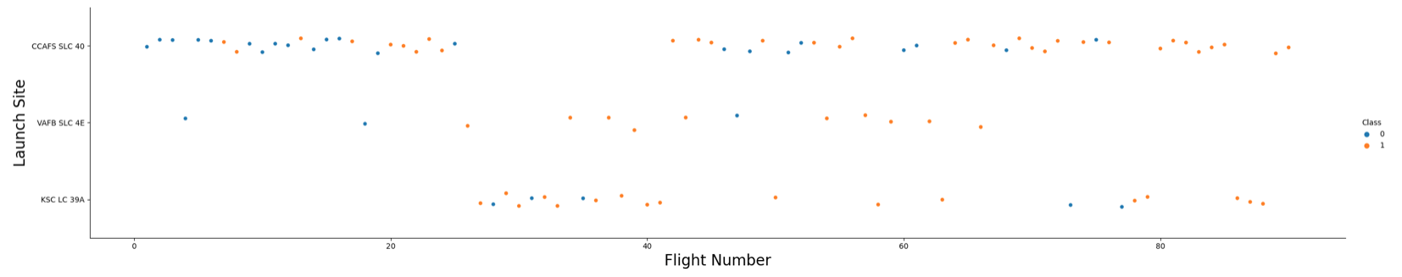
Flight Number vs. Launch Site
It could be clearly noticed that launches from the launch site
CCAFS SLC 40 are significantly higher compared to the other sites.

Slide 22
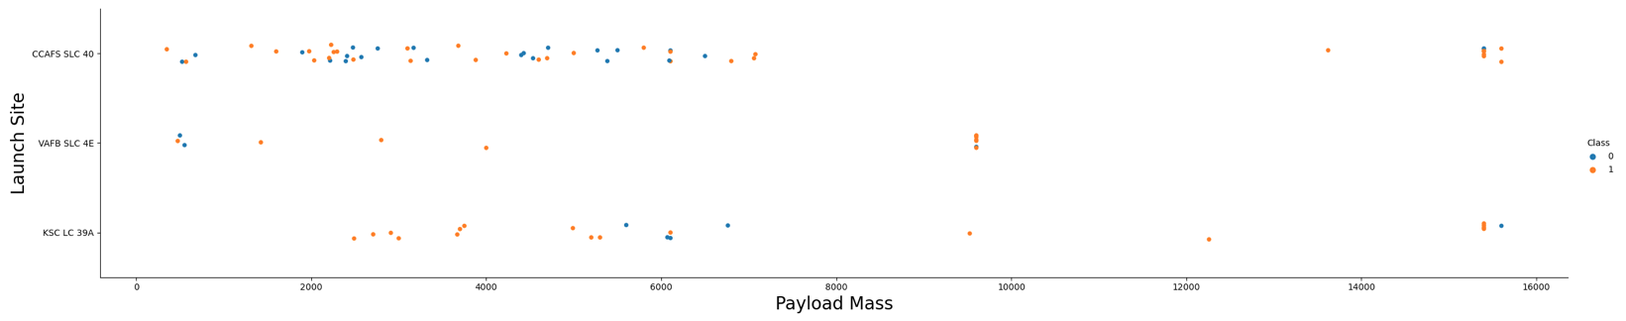
Payload Mass vs. Launch Site
It is noticable that for the VAFB SLC 4E launch site there were no rockets launched for load mass > 10000.
The majority of launches for lower load masses were from the launch site CCAFS SLC 40.

Slide 23
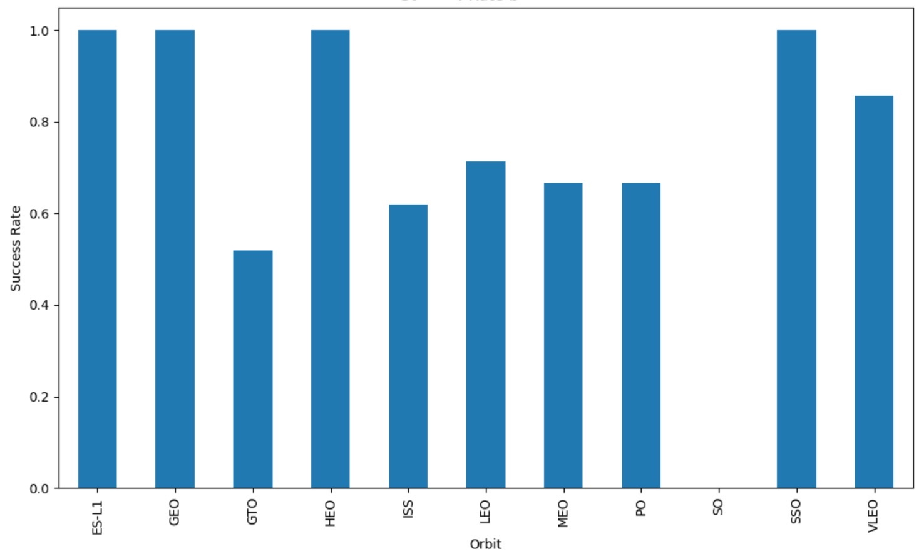
Success Rate vs. Orbit Type
The orbit types ES-L1, GEO, HEO
and SSO had the highest success
rates.

Slide 24
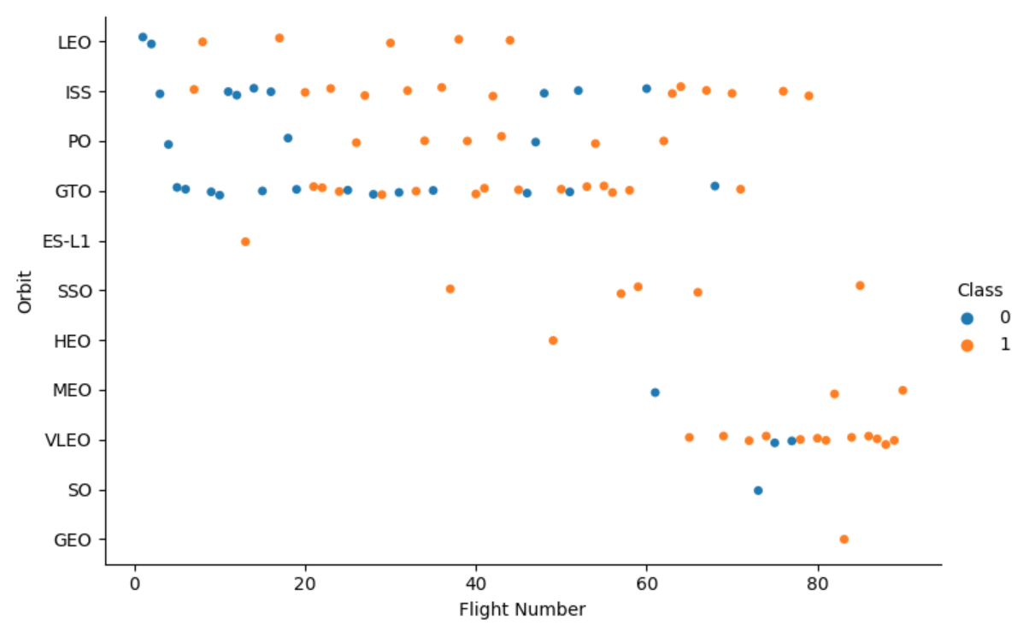
Flight Number vs. Orbit Type
LEO orbit success was related to
the number of flights.
No relationship between flight
number & CTO orbit success.
More VLEO orbit launches were
noticed in the recent most of
which were successful.

Slide 25
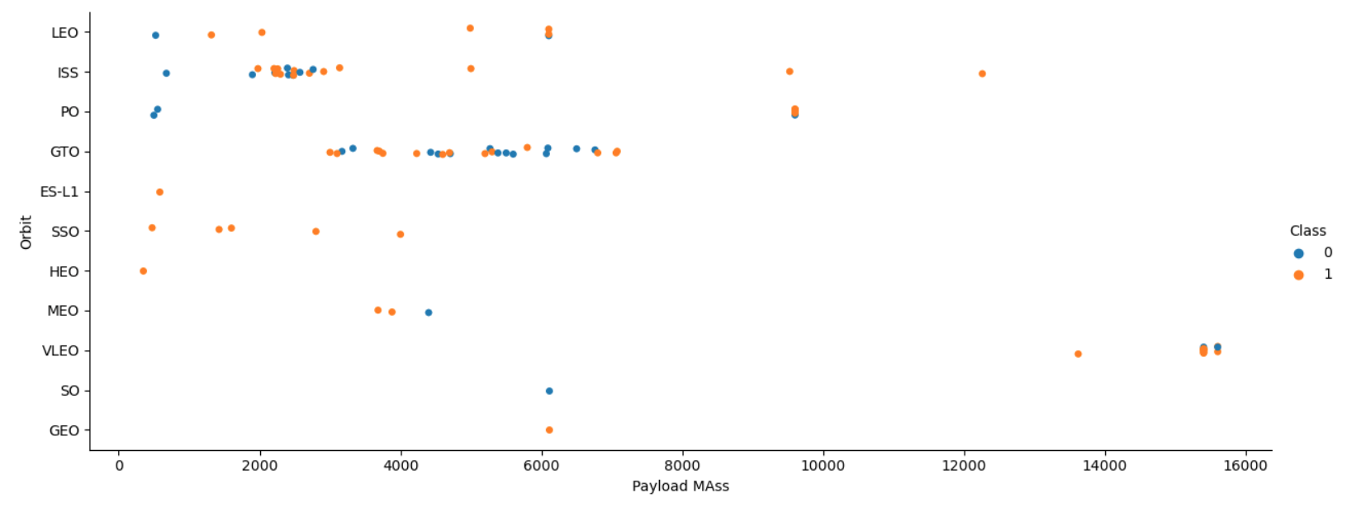
Payload Mass vs. Orbit Type
It was observed that successful landing rates were more for orbits LEO and ISS with heavy payload masses

Slide 26
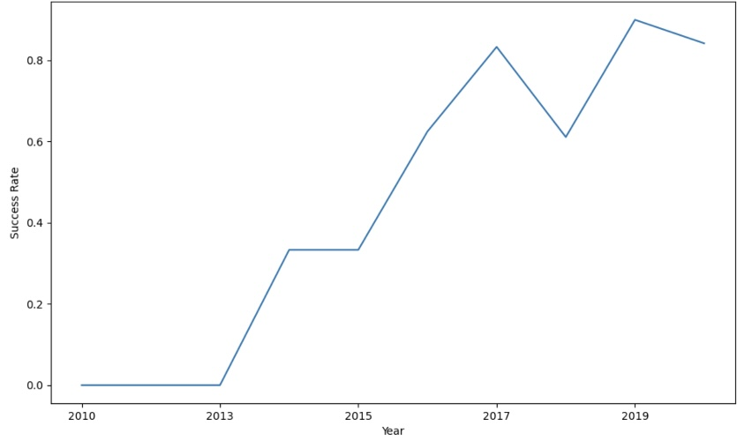
Launch Success Yearly Trend
Launch success rate since 2013
kept increasing till 2020.

Slide 27
INSIGHTS FROM EDA WITH SQL

Slide 28
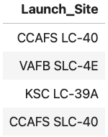
All Launch Site Names
Four unique launch site names were detected.

Slide 29
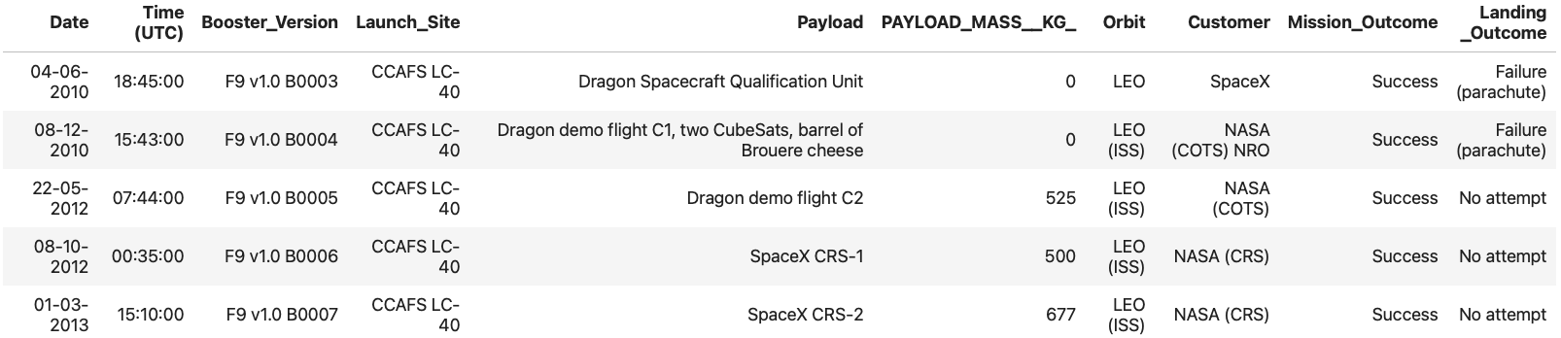
Launch Site Names Began with ‘CCA’

Slide 30
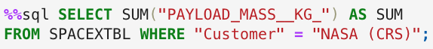
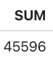
Total Payload Mass
Calculated total payload carried by boosters from NASA.

Slide 31
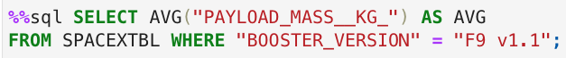
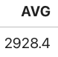
Average Payload Mass by F9 v1.1

Slide 32
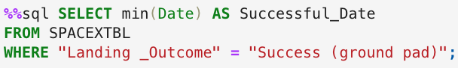
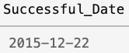
First Successful Ground Landing Date
The date of the first successful landing outcome on ground pad.

Slide 33
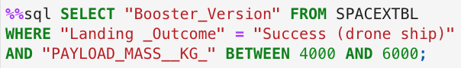
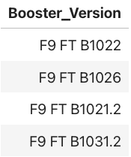
Successful Drone Ship Landing with Payload Between 4000 and 6000
Names of the boosters that had successfully landed on drone ships and had payload mass between 4000 and 6000.

Slide 34
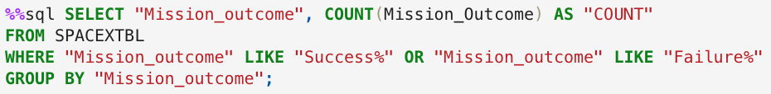
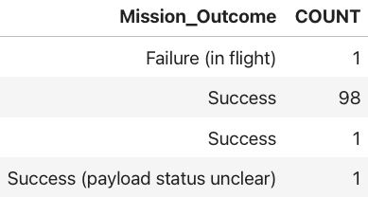
Total Number of Successful and Failure Mission Outcome

Slide 35
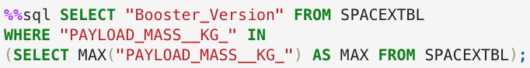
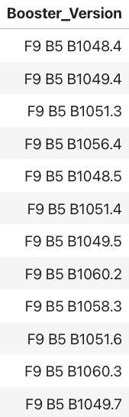
Boosters Carried Maximum Load
Names of boosters that had carried the maximum payload
mass using subquery.

Slide 36
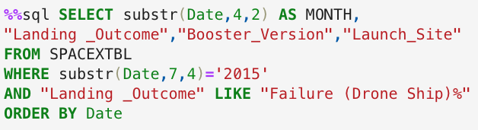
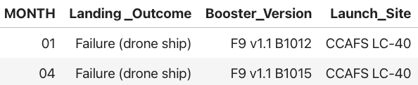
2015 Launch Records
List of the failed landing outcomes in drone ships, their booster versions and launch site names in year 2015.

Slide 37
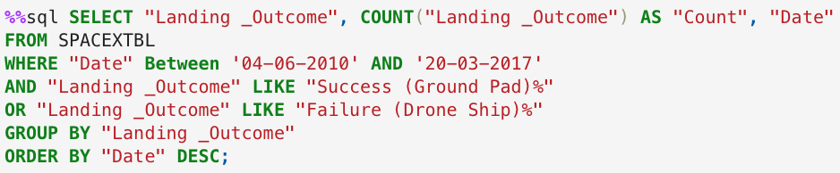
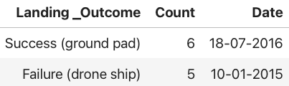
Rank Landing Outcomes Between 2010-06-04 and 2017-03-20
Ranking the count of landing outcomes (Failure (drone ship)
or Success (ground pad)) between the date 2010-06-04 and
2017-03-20.

Slide 38
INSIGHTS FROM LAUNCH SITES PROXIMITIES
ANALYSIS

Slide 39
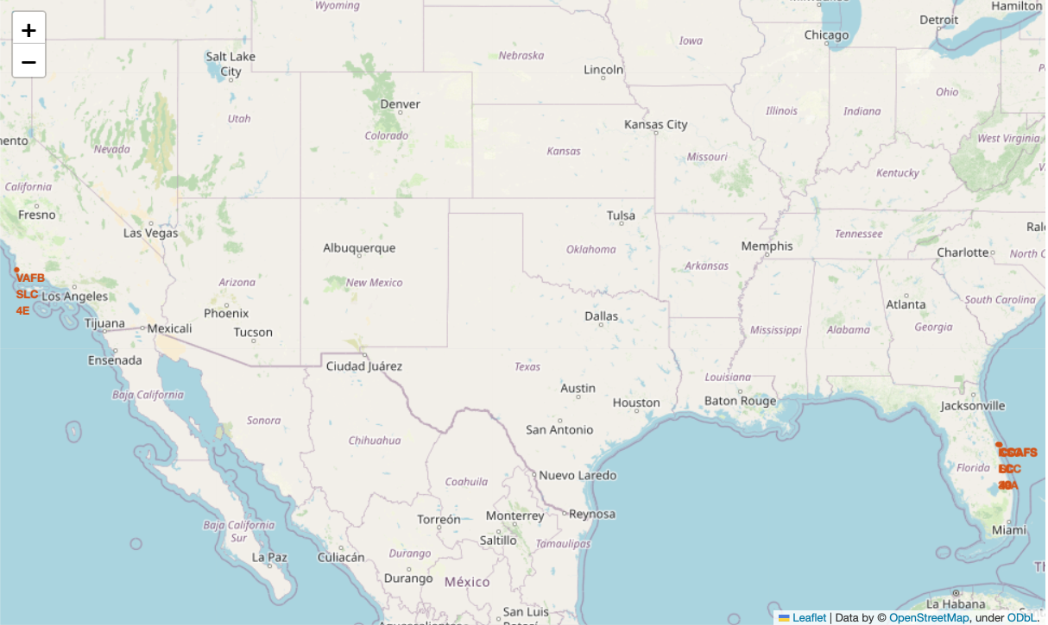
All Launch Sites
A folium.Circle and folium.Marker for each launch site were added on the site map.

Slide 40
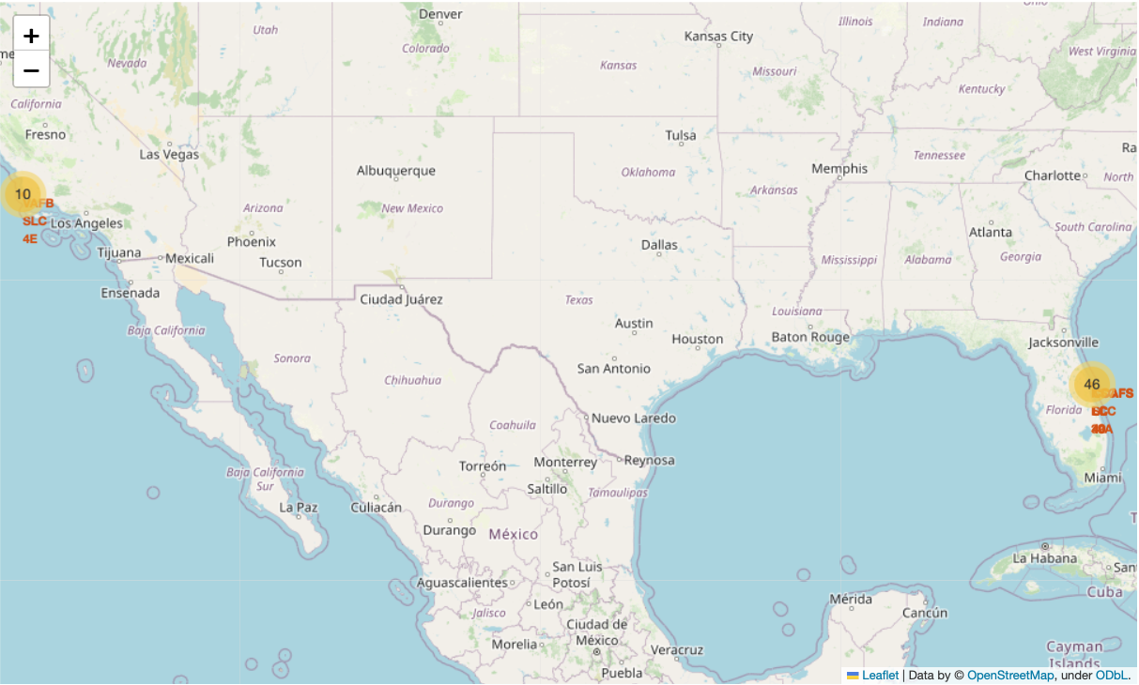
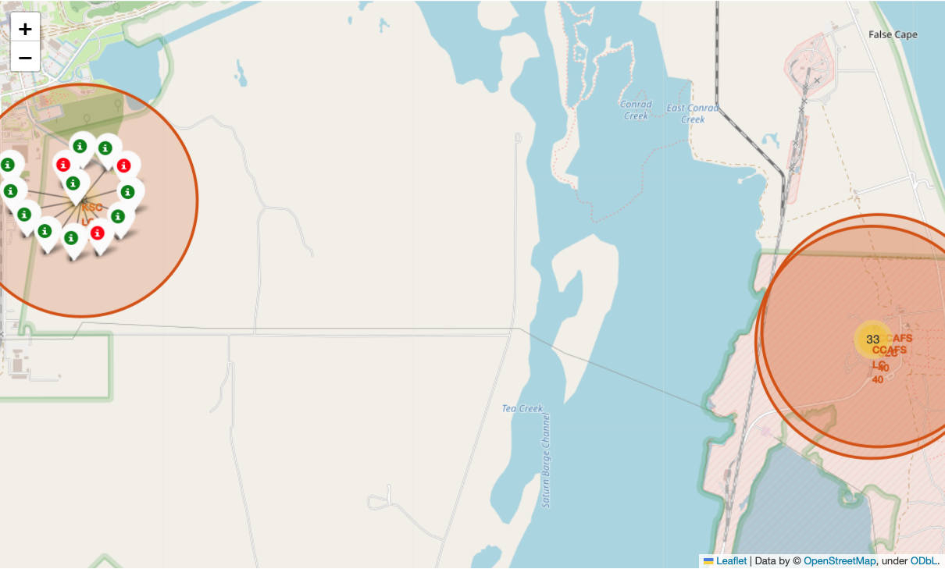
Success/Failed Launches for Each Site
A marker_cluster was created and a color labeled folium.Marker for each launch site was added to the marker_cluster with green color for class 1 and red color for class 0.

Slide 41
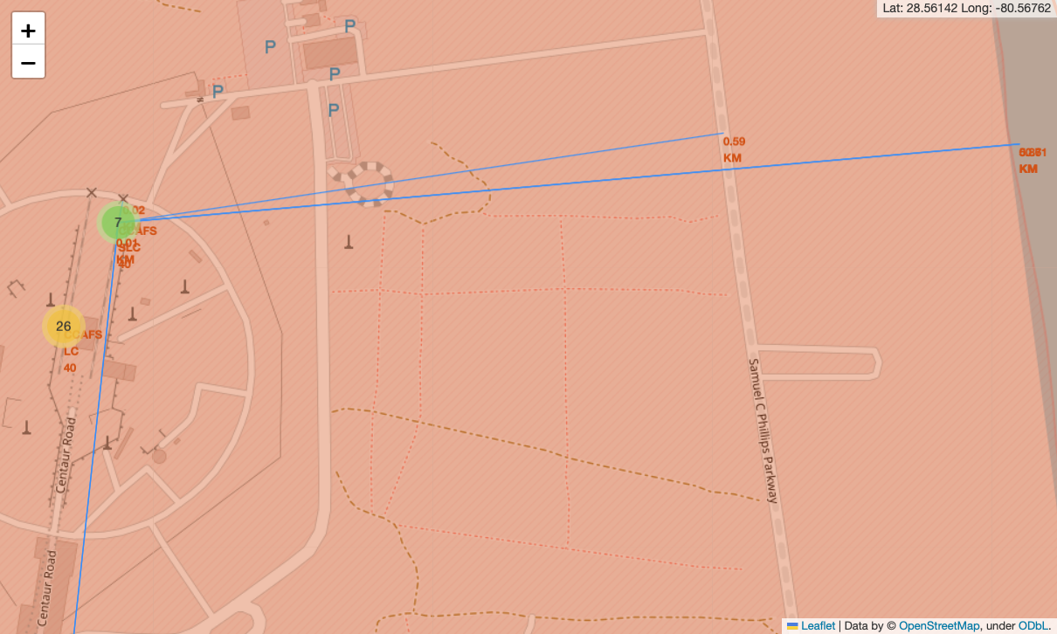
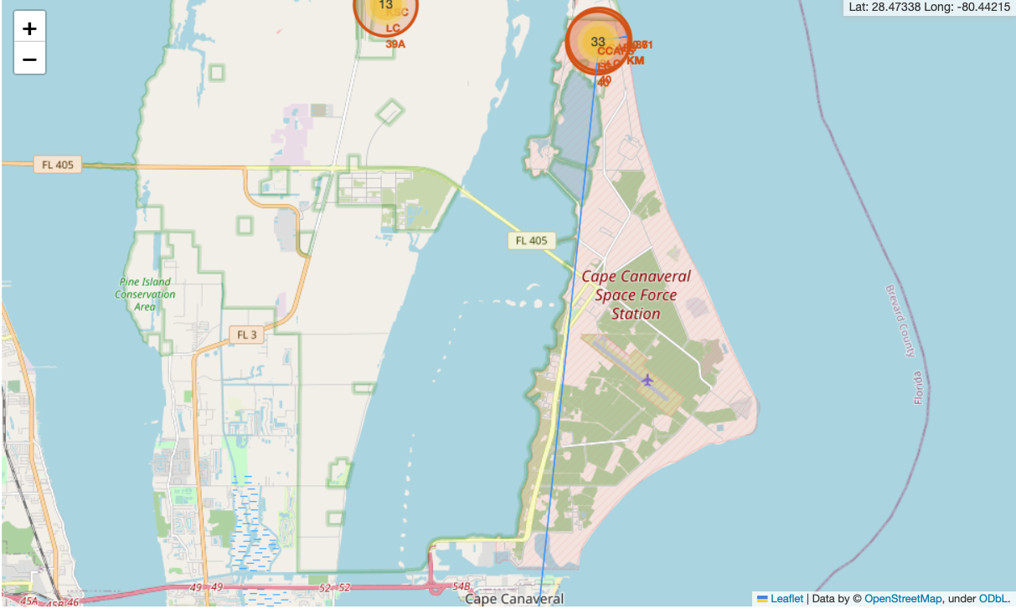
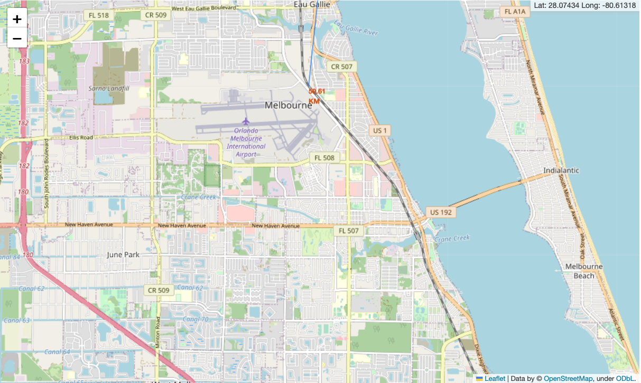
Launch Site and Proximities
Lines were drawn between one launch
site and its closest coastline point,
railway, highway and city.

Slide 42
INSIGHTS FROM DASHBOARD

Slide 43
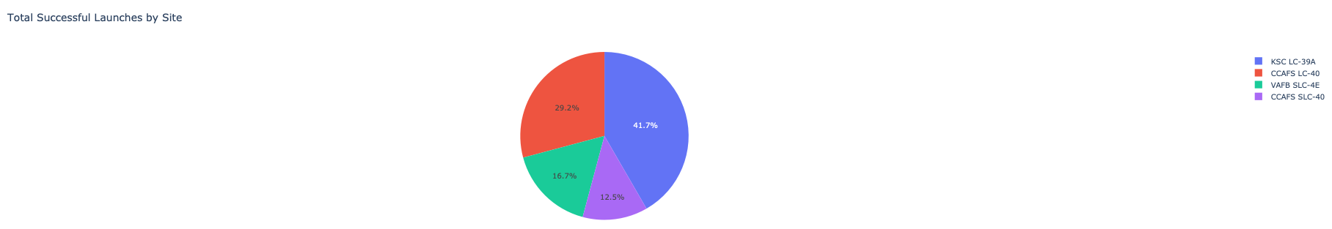
Launch Success Count for All Sites
KSC LC-39A launch site had the most successful launches compared to all the other sites.

Slide 44
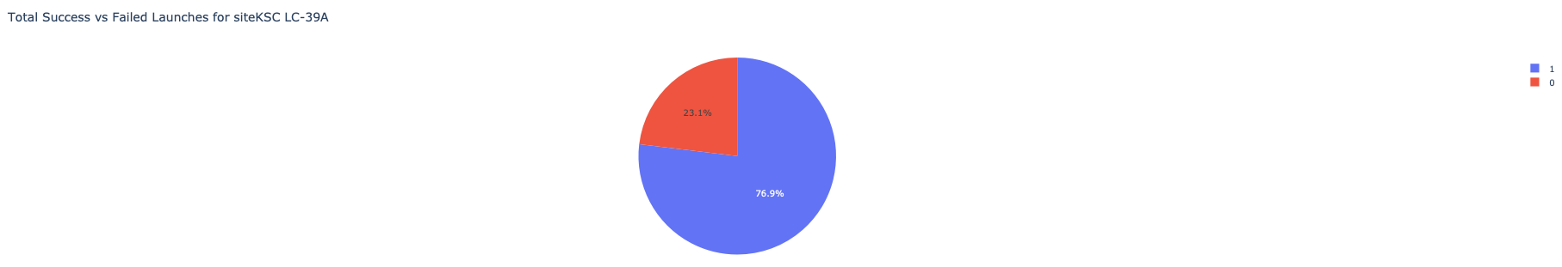
Launch Site with The Highest Success Rate
KSC LC-39A launch site achieved 76.9 % success rate compared to 23.1 % failure rate.

Slide 45
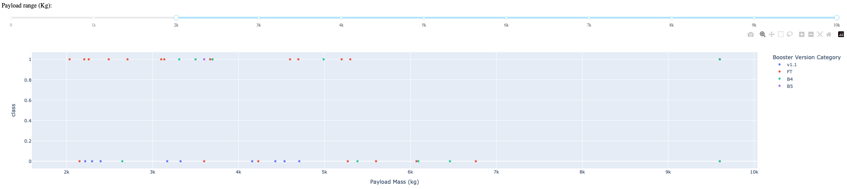
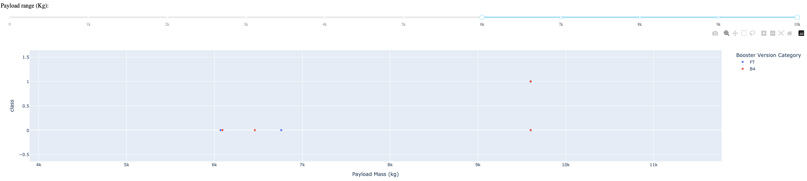
Payload vs. Launch Outcome Scatter Plot
It was noticed that the success rate was higher with lighter weighted payloads.

Slide 46
RESULTS OF PREDICTIVE ANALYSIS
(CLASSIFICATION)

Slide 47
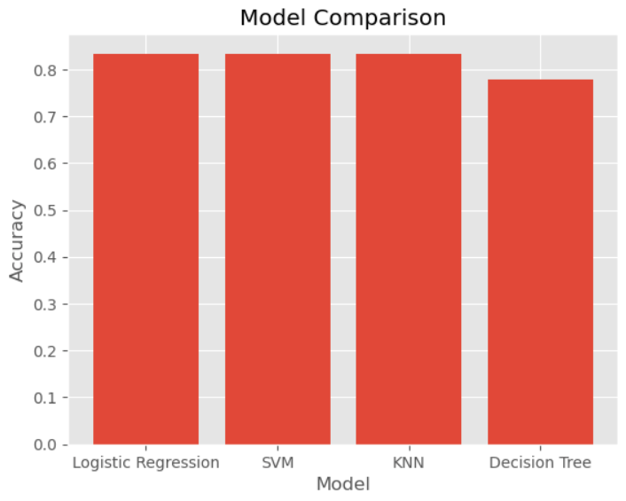
Classification Accuracy
Logistic Regression, SVM and KNN
models had the same accuracy of
83.33 % compared to less accuracy
of the Decision Tree classifier that
had 77.78 % accuracy.

Slide 48
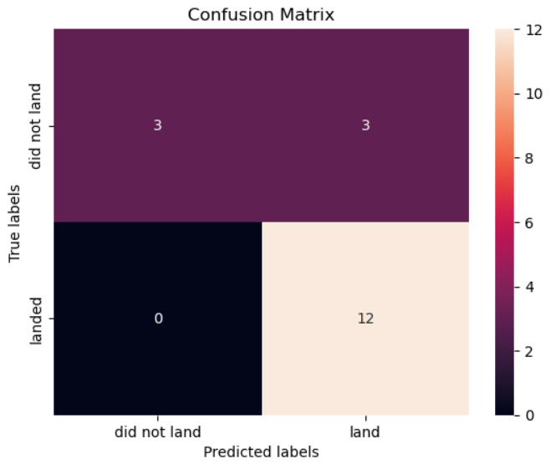
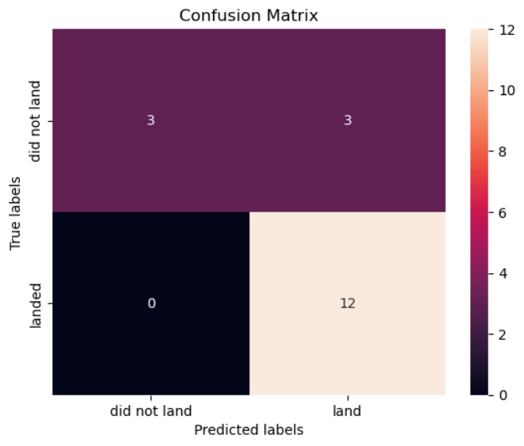
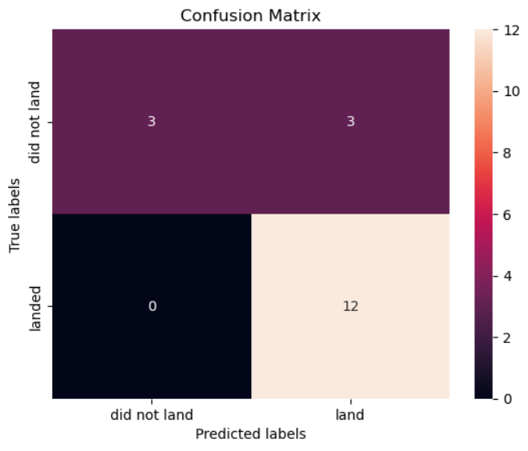
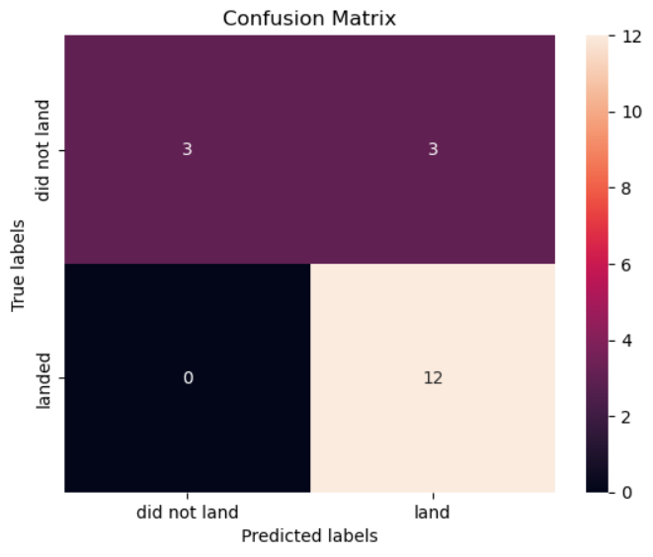
Confusion Matrix

Slide 49
CONCLUSIONS

Slide 50
The orbit types ES-L1, GEO, HEO and SSO have the highest success rates.
Low weighted payloads have higher success rate.
Launch sites are chosen as far as possible from cities.
KSC LC-39A launch site had the most successful launches compared to all the other sites.
Logistic regression, SVM & KNN models are the best to predict the accuracy for this project.

Slide 51

THANK YOU

